Slide 1
Learning Objective 15-1
Cost Accounting Systems

Slide 2
Outline
Process cost system
Job order cost system
Job order cost flow

Slide 3
Cost Accounting
Cost Accounting involves measuring, recording, and reporting product costs.
The objective is to provide unit cost information for pricing, cost control, inventory valuation, financial statement presentation.
Two basic types of cost accounting systems:
(1) a process cost system
(2) a job order cost system

Slide 4
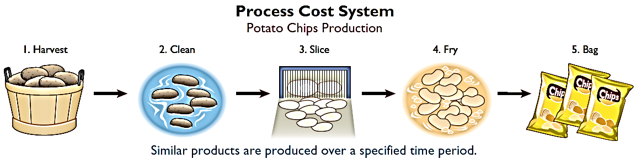
Process Cost System
Used when a large volume of similar products are manufactured (cereal, refining of petroleum, production of ice cream).
Production is continuous.
Costs are accumulated for a time period (week or month).
Costs are assigned to departments or processes for a specified period of time.

Slide 5
Job Order Cost System
Costs are assigned to each job or batch.
Each job or batch has its own distinguishing characteristics.
Objective is to compute the cost per job.
Measures costs for each job completed – not for set time periods.

Slide 6
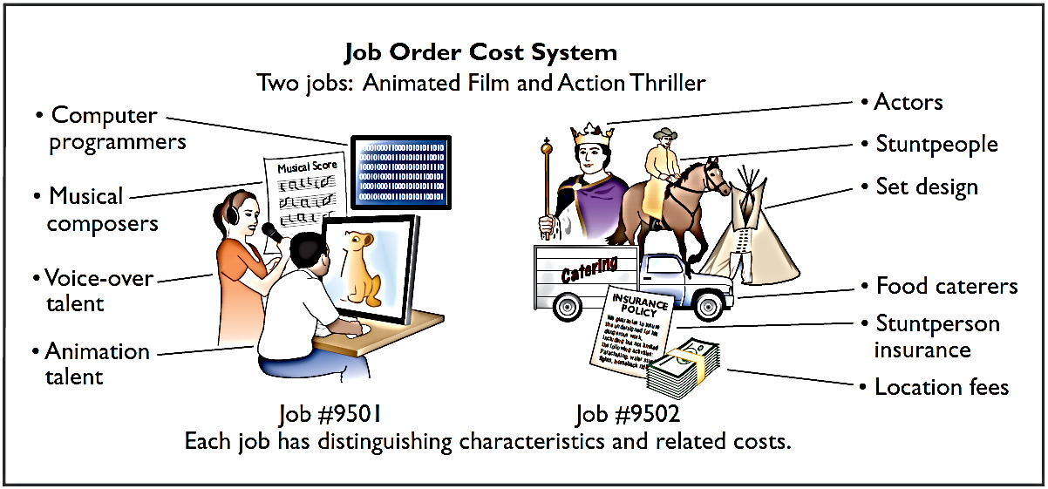
Job Order Cost System
Job order cost system for Disney as it produced two different films.

Slide 7
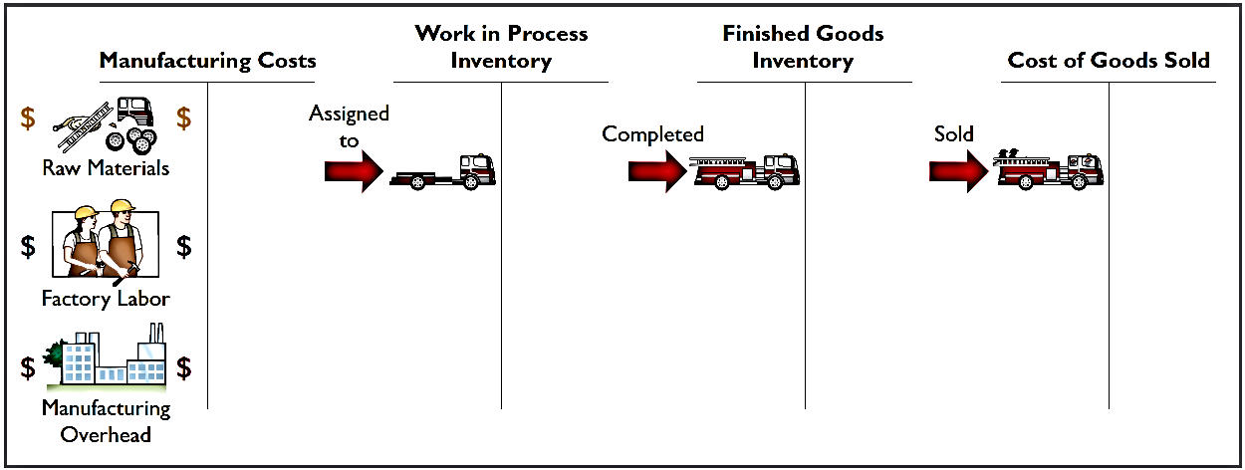
Job Order Cost Flow
The flow of costs parallels the physical flow of the materials as they are converted into finished goods.
Companies first accumulate manufacturing costs and they then assign the costs to the work done.
Accumulation
Assignment

Slide 8
Accumulating Manufacturing Costs
Raw Material Costs
Illustration: Wallace Company purchases, on account, 2,000 lithium batteries (Stock No. AA2746) at $5 per unit ($10,000) and 800 electronic modules (Stock No. AA2850) at $40 per unit ($32,000) for a total cost of $42,000 ($10,000 + $32,000). The entry to record this purchase on January 4 is:
Jan. 4 | Raw Materials Inventory | 42,000
 | Accounts Payable | 42,000

Slide 9
Accumulating Manufacturing Costs
Factory Labor Costs
Consists of three costs:
Gross earnings of factory workers
Employer payroll taxes on these wages
Fringe benefits (such as sick pay, pensions, and vacation pay) incurred by the employer

Slide 10
Accumulating Manufacturing Costs
Factory Labor Costs
Illustration: Wallace incurs $32,000 of factory labor costs. The entry to record factory labor (both direct and indirect) for the month is:
Jan. 31 | Factory Labor | 32,000
 | Payroll Liabilities | 32,000

Slide 11
Accumulating Manufacturing Costs
Manufacturing Overhead Costs
Many types of overhead costs
Property taxes, depreciation, insurance, and repairs related to the manufacturing process
Costs unrelated to manufacturing are expensed as period costs
Costs related to manufacturing process are accumulated in the Manufacturing Overhead account
Manufacturing overhead subsequently assigned to work in process

Slide 12
Accumulating Manufacturing Costs
Manufacturing Overhead Costs
Illustration: Using assumed data, the summary entry for manufacturing overhead (other than indirect materials and indirect labor) in Wallace Company is:
Jan. 31 | Manufacturing Overhead | 13,800
 | Utilities Payable | 4,800
 | Prepaid Insurance | 2,000
 | Accounts Payable (for repairs) | 2,600
 | Accumulated Depreciation | 3,000
 | Property Taxes Payable | 1,400

Slide 13
DO IT! 1: Accumulating Manufacturing Costs
During the current month, Ringling Company incurs the following manufacturing costs:
1. Raw material purchases of $4,200 on account.
2. Factory labor of $18,000.
3. Factory utilities of $2,200 are payable, prepaid factory insurance of $1,800 has expired, and depreciation on the factory building is $3,500.
Prepare journal entries for each type of manufacturing cost.

Slide 14
DO IT! 1: Accumulating Manufacturing Costs
1. Raw material purchases of $4,200 on account.
Raw Materials Inventory | 4,200
Accounts Payable | 4,200
2. Factory labor of $18,000.
Factory Labor | 18,000
Payroll Liabilities | 18,000
3. Factory utilities of $2,200 are payable, prepaid factory insurance of $1,800 has expired, and depreciation on the factory building is $3,500.
Manufacturing Overhead | 7,500
Utilities Payable | 2,200
Prepaid Insurance | 1,800
Accumulated Depreciation | 3,500

